Slide 1


K. RAMAKRISHNAN COLLEGE OF ENGINEERING
(AUTONOMOUS), SAMAYAPURAM - TRICHY DEPARTMENT OF CSE
CGB1221 – DATABASE MANAGEMENT SYSTEMS
PERSONAL EXPENSE TRACKER
PRESENTED BY SUPERVISOR
K. KRISHKANTH Mr. R. Sasikumar M.E., (Ph.D.,),
8115U23CS051 Assistant Professor / CSE.

Slide 2
PRESENTATION OVERVIEW
Project Introduction
Objective
Problem Statement
Technologies Used
ER Diagram
Modules Used
Output Screenshots
Conclusion
Future Scope
References

Slide 3
PROJECT INTRODUCTION
The Personal Expense Tracker Application helps users manage their finances by tracking income and expenses across categories. It provides real-time budget insights, alerts for overspending, and a summary of expenses. Built with Java Swing, it aims to help users stay within their budget and manage money effectively.

Slide 4
OBJECTIVE
To help users manage monthly finances by tracking income, expenses, and providing budget insights for effective money management.

Slide 5
PROBLEM STATEMENT
Many individuals struggle to track their expenses and manage their budget effectively, leading to overspending. There is a need for an easy-to-use tool that helps users monitor their income, categorize expenses, and stay within their financial limits.

Slide 6
TECHNOLOGIES USED
Frontend:
Python: Used to implement the Graphical User Interface.
Backend:
MySQL : Used for secure storage of user data (passwords hashed).
Development Tools:
IDE: Visual Studio Code for writing and managing code.

Slide 7
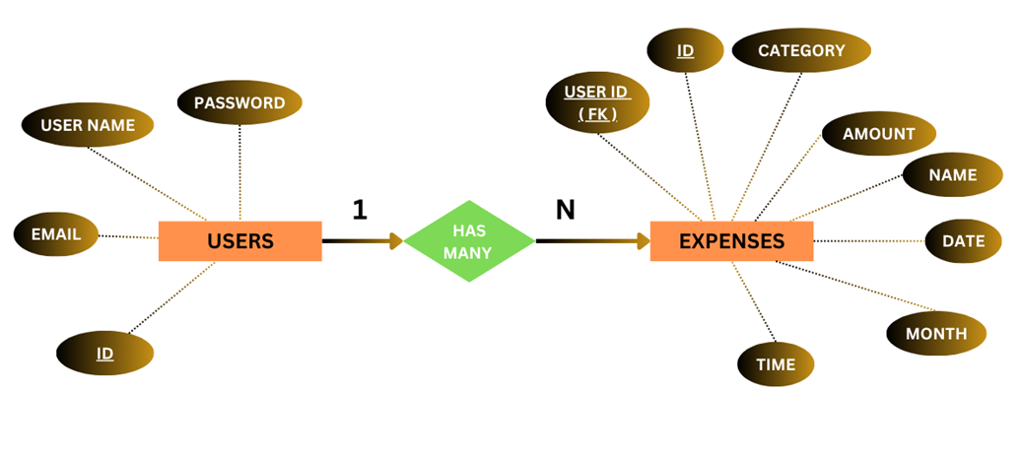
ER DIAGRAM

Slide 8
MODULES USED
Authentication Module
Database Initialization Module
Expense Tracking Module
Data Visualization Module
PDF Report Generation Module
Filter Module
Suggestions Module
Delete Selected Module

Slide 9
MODULE 1 – AUTHENTICATION
Handles secure login and registration for users.
Implements password hashing with SHA-256 and duplicate check.
Ensures only authenticated users access the application.

Slide 10
MODULE 2 – DATABASE INITIALIZATION
Initializes and connects to the MySQL expense_tracker database.
Creates users and expenses tables with required relationships.
Handles connection failures and ensures backend readiness.

Slide 11
MODULE 3 – EXPENSE TRACKING
Allows users to add, edit, and manage expense records.
Supports entry of amount, category, date, and time.
Displays a personalized interface after login.

Slide 12
MODULE 4 – DATA VISUALIZATION
Uses matplotlib to display expenses as graphs or charts.
Shows category-wise and month-wise spending patterns.
Helps users make better budgeting decisions through visuals.

Slide 13
MODULE 5 – PDF GENERATION
Exports user expenses into professionally styled PDF reports.
Uses reportlab for formatting tables and headings.
Supports saving files with optional charts or images.

Slide 14
MODULE 6 – FILTER
Filters expenses by category, date range, or amount range.
Supports precise record lookup and spending analysis.
Enhances user experience through targeted viewing.

Slide 15
MODULE 7 – SUGGESTIONS
Provides budgeting tips based on spending behavior.
Detects overspending in categories and alerts the user.
Promotes mindful and responsible financial habits.

Slide 16
MODULE 8 – DELETE SELECTED
Lets users delete selected expense records from the list.
Updates both the UI and database upon deletion.
Prevents accidental deletions with confirmation messages.

Slide 17
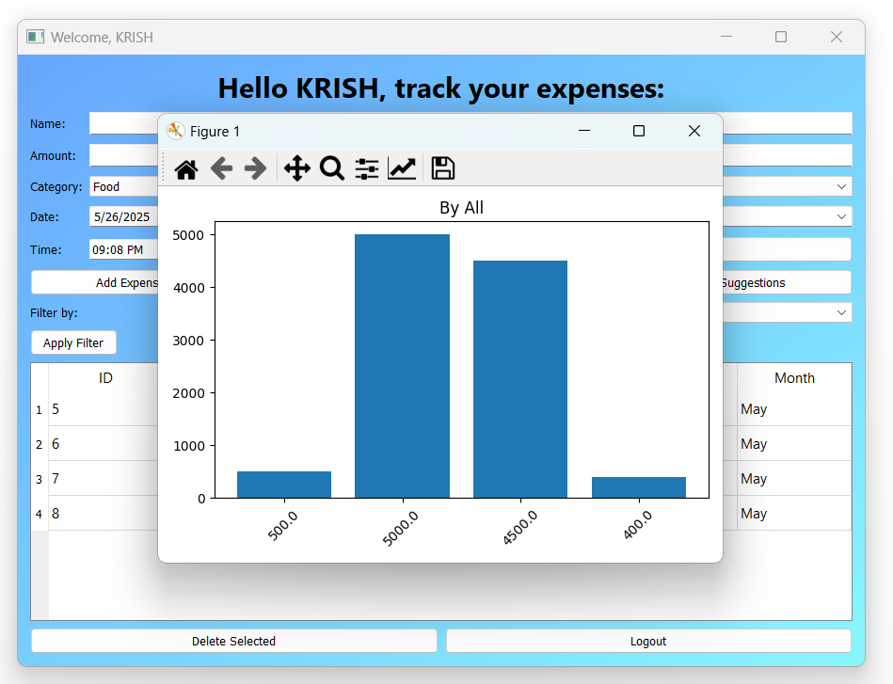
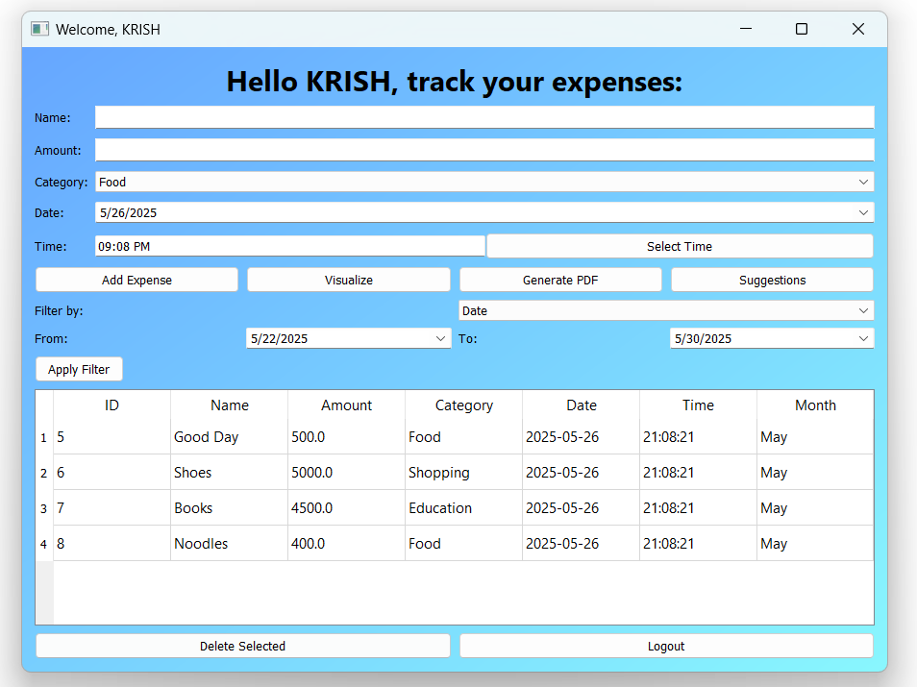
OUTPUT SCREENSHOTS

Slide 18
CONCLUSION
Secure & Efficient: Implements encrypted authentication and robust database management for safe, organized financial tracking.
User-Friendly & Insightful: Simple interface with filtering, categorization, and budget reports to support informed financial decisions.
Scalable Design: Modular architecture enables easy updates, maintenance, and integration of future features.

Slide 19
FUTURE SCOPE
Smart Insights: Integrate machine learning for spending predictions and personalized budgeting advice.
Enhanced Connectivity: Add multi-currency support, bank sync, and real-time updates for global usability.
Mobile & Collaborative: Develop mobile apps with alerts and shared expense tracking for greater accessibility and group use.

Slide 20
REFERENCES
Mark Lutz. Learning Python, 5th Edition. O'Reilly Media, 2013.
Michael Driscoll. Python 101, Leanpub, 2020.
PyQt5 Tutorial - https://www.riverbankcomputing.com/static/Docs/PyQt5/
MySQL Developer Documentation - https://dev.mysql.com/doc/

Slide 21


